Slide 1
ELECTRICAL MEASUREMENTS AND MEASURING INSTRUMENTS
S.SUNDARARAJAN
FEDERAL INSTITUTE OF SCIENCE AND TECHNOLOGY

Slide 2
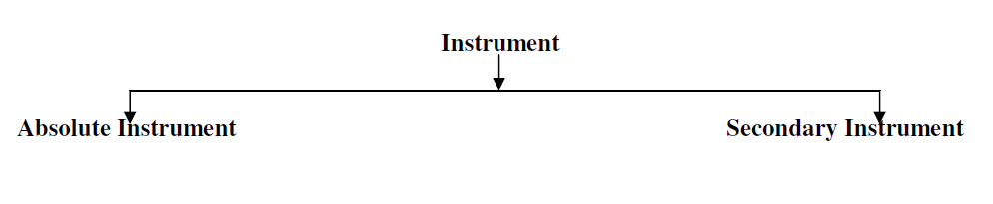
MEASUREMENTS
Definition of instruments An instrument is a device in which we can determine the magnitude or value of the quantity to be measured. The measuring quantity can be voltage, current, power and energy etc. Generally instruments are classified in to two categories.

Slide 3
Absolute Instruments
Absolute Instruments give the magnitude of the quantity under measurements in terms of physical constants of the instruments.
Ex: Tangent Galvanometer, Rayleigh’s Current Balance.
Tangent galvanometer is a device used for measuring current. It works on the principle of tangent law. A magnetic needle suspended at a point where there are two crossed fields at right angles to each other will come to rest in the direction of the resultant of the two fields.

Slide 4
Secondary Instruments
The quantity under measurement can only be measured by observing the output of the instrument.
The secondary instrument should be calibrated by comparing with an absolute measurement or another secondary measurement which has already been calibrated against an absolute instrument.
Eg: Voltmeter, Pressure Gauge.

Slide 5
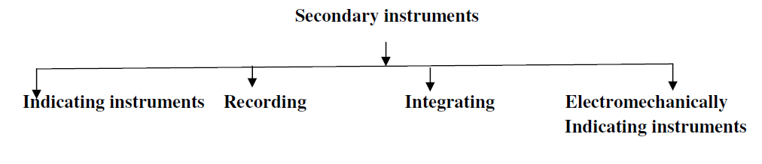
Secondary Instruments

Slide 6
Indicating Instruments
These instruments directly indicate the value of the electrical quantity at the time when it is being measured. In these instruments , a pointer moving over a graduated scale directly gives the value of the electrical quantity being measured.
Ammter, Voltmeter and wattmeter

Slide 7
Integrating Instruments
The instruments which measure the total quantity of electricity or electrical energy in a given time are called integrating instruments. In such instruments, there are a set of dials and pointers which register the total quantity of electricity or electrical energy supplied to the load.
Ampere-Hour Meter, Watt hour meter

Slide 8
Recording Instruments
Gives the continuous record of the variations of the electrical quantity to be measured. A recording instrument is merely an indicating instrument with a pen attached to its pointer.
The pen rests lightly on a chart wrapped over a drum moving with a slow uniform speed.
The motion of the drum is in a direction perpendicular to the direction of the pointer.
The path traced out by the pen indicates the manner in which the quantity being measured, has varied during the time of the record.

Slide 9
Working Standard
A standard is physical representation of a unit of measurement. A known accurate measure of physical quantity is termed as a standard.
Different types of “standards of measurement” are classified in categories (i) international, (ii) primary, (iii) secondary, and (iv) working standards.

Slide 10
International Standard
International standards are defined by International agreement.
International Bureau of Weights and Measures
It is defined as the resistance offered by a column of mercury having a mass of 14.4521 gms, uniform cross-sectional area and length of 106.300 cm, to the flow of constant current at the melting point of ice

Slide 11
Absolute Standard or Primary standard
International units were replaced in 1948 by absolute units. These units are more accurate than International units, and differ slightly from them. For example
National Standards laboratories
A primary standard quantity will have only one value and it is fixed. An instrument which is used to measure the value of primary standard quantity is called primary standard instrument. It gives the accurate value of the quantity being measured.

Slide 12
Secondary Standard
The value of the secondary standard quantity is less accurate than primary standard one. It is obtained by comparing with primary standard. For measurement of a quantity using secondary standard instrument, pre-calibration is required.
The secondary standard is compared at regular intervals with primary Stands and records their deviation. These Standards are distributed to a number of places where they are kept under safe custody.

Slide 13
Working Standards
The working standard is used for actual measurement in workshop or laboratories by the workers. These standards should also be as accurate as possible to the tertiary standard. But sometimes, lower grades of materials can be used for their manufacturing to reduce cost.

Slide 14
Calibration of Instruments
Instrument calibration is one of the primary processes used to maintain instrument accuracy.
Calibration is the process of configuring an instrument to provide a result for a sample within an acceptable range.
Eliminating or minimizing factors that cause inaccurate measurements is a fundamental aspect of instrumentation design.
Checking with standard instruments.
Although the exact procedure may vary from product to product, the calibration process generally involves using the instrument to test samples of one or more known values called “calibrators.”
The results are used to establish a relationship between the measurement technique used by the instrument and the known values.

Slide 15
Reason for calibration
Calibration may be required called for the following reasons
A new instrument
After an instrument has been repaired or modified
When a specified time period has elapsed.
When a specified usage (operation hours) has elapsed.
Before and/ or after a critical instrument
After an event, for example after an instrument has been exposed to a shock, vibration or physical damage.
Sudden change in weather

Slide 16
Types of Calibration
Manual Calibration
As an example, a manual process may be used for calibration of a pressure gauge. The procedure requires multiple steps, to connect the gauge under test to a reference master gauge and an adjustable pressure source, to apply fluid pressure to both reference and test gauges at definite points over the span of the gauge, and to compare the readings of the two.
The gauge under test may be adjusted to ensure its zero point and response to pressure comply as closely as possible to the intended accuracy.
Each step of the process requires manual record keeping.

Slide 17
Types of Calibration
Automatic Calibration:
Pressure Calibrator, Pressure Sensor

Slide 18
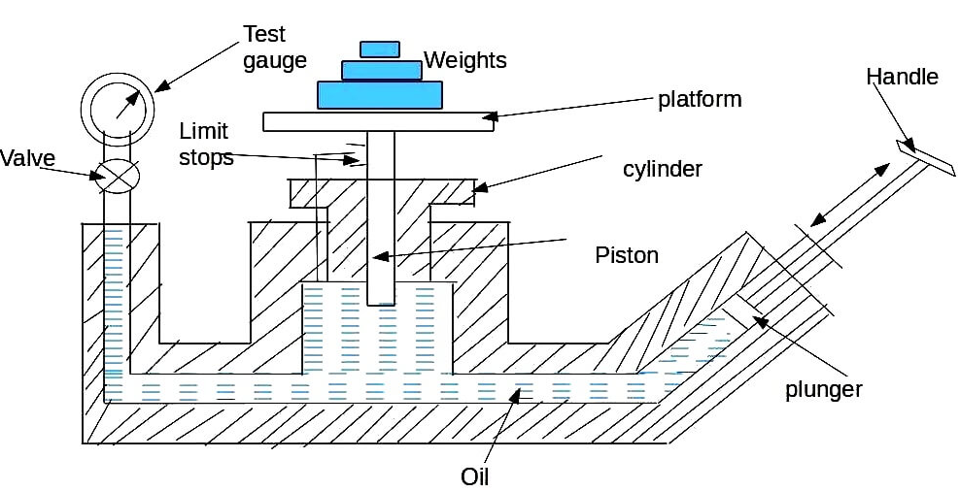
Dead Weight Tester

Slide 19
DEAD WEIGHT TESTER
PA = Mg + F
P = Mg + F / A
where, P = pressure
M = Mass; Kg
g = Acceleratoion due to gravity ; m/s²
F = Friction drag; N
A = Eqivalent area of piston – cylinder combination; m²
Thus the pressure P which is caused due to the weights placed on the platform is calculated. After calculating P , the plunger is released.

Slide 20
DEAD WEIGHT TESTER
Now the pressure gauge to be calibrated is fitted at an appropriate place on the dead weight tester. The same known weight which was used to calculated P is placed on the platform.
Due to the weight, the piston moves downwards and exerts a pressure P on the fluid. Now the valve in the apparatus is opened so that the fluid pressure P is transmitted to the gauge, which makes the gauge indicate a pressure value.
This pressure value shown by the gauge should be equal to the known input pressure P.

Slide 21
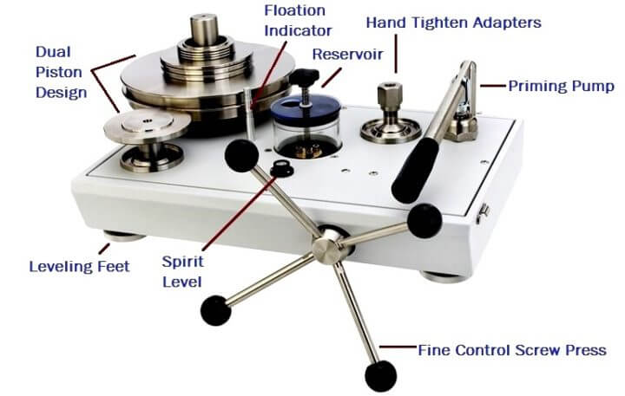
DEAD WEIGHT TESTER

Slide 22
Qualities of Measurement
Accuracy: It is the closeness with which an instrument reading approaches the true value of the quantity under measurement or it is defined as the ability of a device a system to respond to a true value of a measured variable under reference conditions. Thus accuracy of a measurement means conformity to truth.
Precision: Precision is a measure of consistency or repeatability of measurements. It is also known as the degree of exactness for which an instrument is designed to perform.

Slide 23
Qualities of Measurement
Sensitivity: Sensitivity as the ratio of a change in output to the change in input which causes it at steady state conditions.It is also known as the maximum change in an input signal that will not initiate on the output.
Resolution: Resolution is the least incremental value at input or output that can be detected by the measuring device.

Slide 24
Loading Effects
The incapability of the system to faithfully measure, record or control the input signal in undistorted form is called Loading Effect.
Signal Sensing, Conditioning circuit, transmission or detection -------- Loading Effect.
Three stages introduces Loading Effect in Measurement System
Detector – Transducer Stage
Signal Conditioning Stage
Signal Presentation Stage

Slide 25
Loading Effects – Problem-1
A multimeter having a sensitivity of 2000Ω/V is used for measurement of voltage across a circuit having an output resistance of 10KΩ. The open circuit voltage of the circuit is 6V. Find the reading of the multimeter when it is set to 10V scale. Find the Percentage Error?

Slide 26
Loading Effect Problem-2
Suppose the voltmeter of problem-1 is used for measurement of voltage of a circuit having an output resistance of 1000Ω and an open circuit voltage of 6V at its 10V scale. Find the error in measurement?

Slide 27
Loading Effect Problem 3
A 50V range voltmeter is connected across the terminals A and B of the circuit shown in figure. Find the reading of the voltmeter under open circuit and loaded conditions. Find the accuracy and the loading error. The voltmeter has a resistance of 1000kΩ.

Slide 28
Loading Effect Problem 4
It is desired to measure the value of the current in the 500Ω resistor as shown in the figure by connecting a 100Ω ammeter. Find
The actual value of the current
Measured value of the current, and
The percentage error in measurement and the accuracy.

Slide 29

Errors in Measurement-Limiting Error
The limited deviation of the measured value from the true value is known as the limiting error or guarantee error. Such type of error is fixed on the instrument.
The magnitude of the limiting error depends on the design, material and the workmanship used for the construction of the instrument.
Where, A_{a} – actual value A_{s} – specified or rated value δ_{A} – limiting error or tolerance

Slide 30
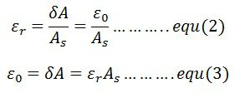
Relative Error
The relative limiting error is defined as the ratio of the limiting error to the nominal value of the measuring quantity. It is expressed as

Slide 31



Relative Error
In limiting error, the specified quantity is taken as the true quantity, and the maximum deviation quantity is known as the incorrect or erroneous quantity.
The relative limiting error,

Slide 32
Relative Error – Problem 1
The nominal value of the resistor is 100 ohms. And the limiting error of the resistance is ±10 ohms. The magnitude of the actual value of the resistance lies between the A_{a} ≥ 90 ohms and A_{a} ≤110 ohms. Find the relative limiting error?

Slide 33

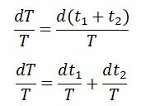
Combination of Quantities with limiting error
Sum of two quantities – The T be the final result which is the sum of the measured quantities t₁ and t₂.
The relative increment of the function is expressed as

Slide 34


Combination of Quantities with limiting error
Sum or difference of two or more quantities

Slide 35
Problem-2
Three Resistors have the following rating.
R1= 37Ω +/- 5%
R2 = 75Ω +/- 5%
R3 = 50Ω +/- 5%
Determine the magnitude and limiting error in ohm and in percent of the resistance of these resistances connected in series.

